Slide 1
Interrupt/System Calls
Kriti Mathur

Slide 2
Interrupt
Definition: An interrupt is a signal to the processor emitted by hardware or software indicating an event that needs immediate attention.
Handled by: Interrupt Service Routines (ISRs) — special functions in the OS.
Example: A keyboard interrupt is a hardware interrupt generated when you press or release a key on your keyboard.
Purpose: To alert the CPU to an urgent task that requires its attention, temporarily halting the current execution flow.

Slide 3
Types Of Interrupts
Hardware interrupts: Triggered by hardware (e.g., keyboard input, mouse movement, disk I/O complete).
Software interrupts: Triggered by a program, often to request a system-level service (e.g., INT 80h in x86 Linux).

Slide 4
Hardware Interrupt
Hardware interrupts are used by devices to communicate that they require attention from the operating system.
Hardware interrupts by sending a signal to CPU via a system bus.
An interrupt number references hardware interrupts.
These numbers are mapped with hardware that created the interrupt.
Enabling the system to monitor/understand:
which device created the interrupt and when it occurred.

Slide 5
Software Interrupt/ Trap
Interrupt generated by executing a instruction.
Software interrupts by a special operation called a System Call or Monitor Call.
Ex: 1. cout in C++ is a kind of interrupt because it would make a system to print something.
2. division by zero

Slide 6
I/O Interrupt
I/O Interrupt (Input/Output Interrupt)
An I/O interrupt is a type of hardware interrupt that occurs when an input or output device needs the CPU's attention — typically when it's done with a task like reading data or sending output.

Slide 7
✅ 1. Synchronous Interrupts
Feature | Details
Timing | Occur at a specific point during instruction execution (predictable)
Triggered by | Internal events caused by the currently running program
Cause | Errors or exceptions in the program
Handling | CPU handles immediately after the faulty instruction
Examples | - Divide by zero error- Invalid memory access- Illegal instruction

Slide 8
✅ 2. Asynchronous Interrupts
Feature | Details
Timing | Occur at any time, unrelated to current instruction execution (unpredictable)
Triggered by | External events from hardware devices
Cause | Devices signaling completion or events
Handling | CPU is interrupted after finishing the current instruction
Examples | - Keyboard key pressed- Mouse moved- Disk I/O completed

Slide 9
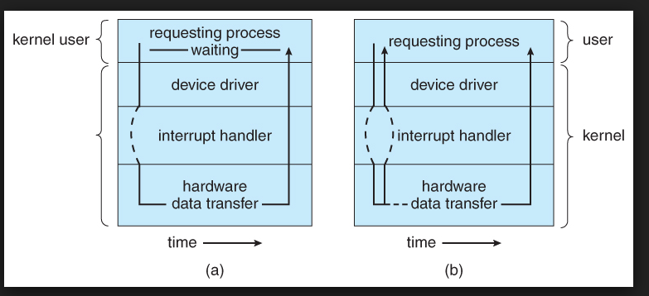
(a) Synchronous (b) Asynchronous

Slide 10
🧠 What is a System Call?
A System Call is a programmatic way in which computer program to request a service from the operating system's kernel.

Slide 11
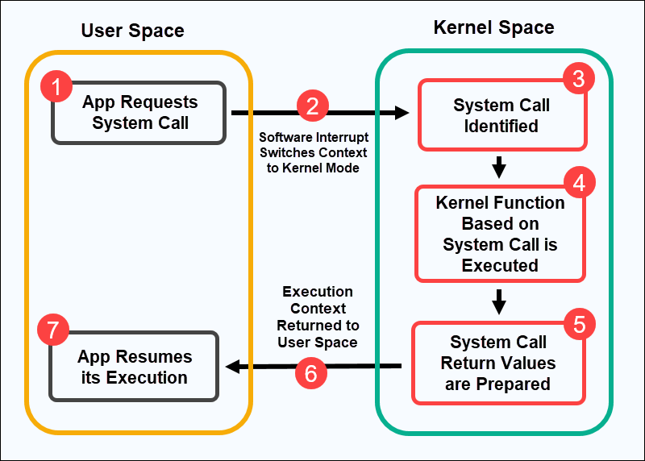
Working of System Call

Slide 12
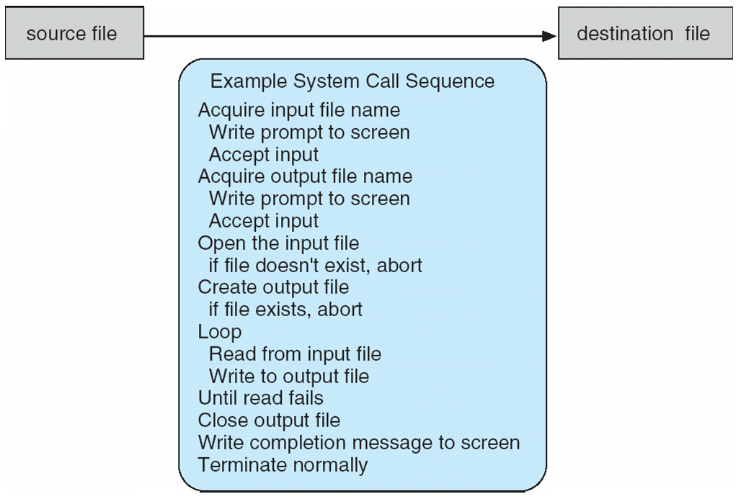
Example of System Calls
System call sequence to copy the contents of one file to another file

Slide 13
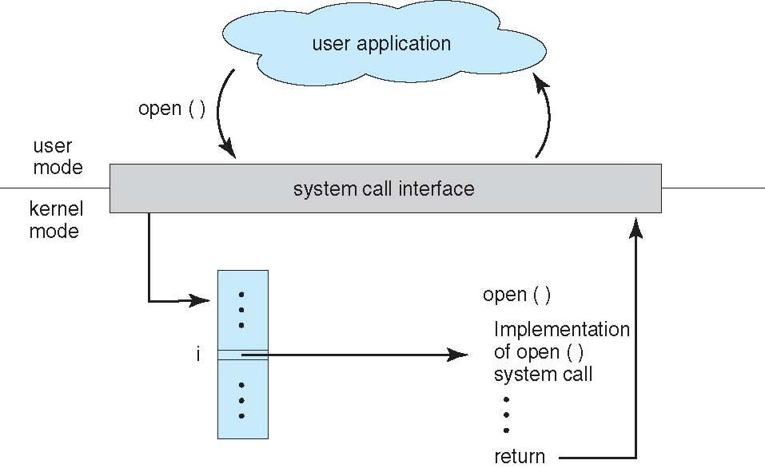

🔗 Relationship: API – System Call – Operating System
API is what you write in your code. It calls a System Call, which tells the Operating System (OS) to do the real work.

Slide 14
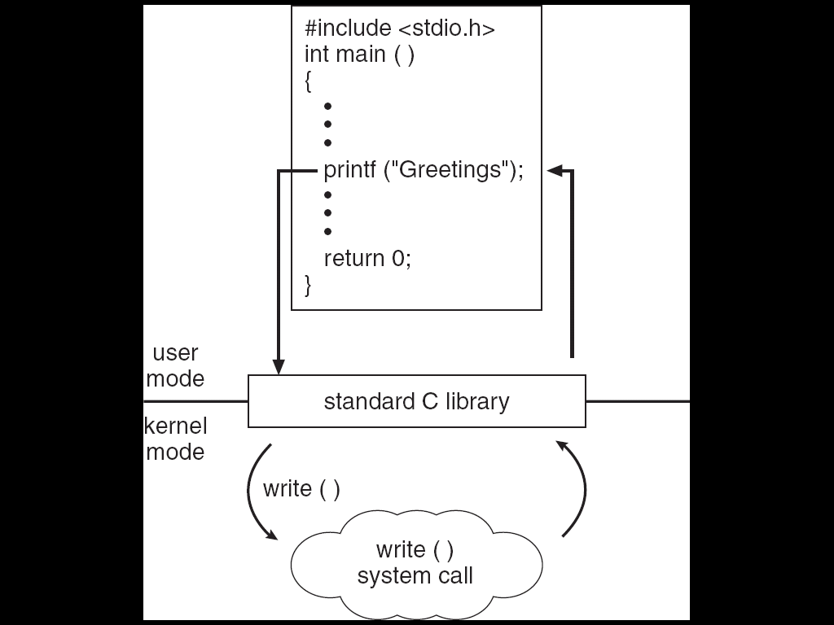
Standard C Library Example
C program invoking printf() library call, which calls write() system call

Slide 15
System Call Parameter Passing
Three general methods used to pass parameters to the operating system (OS) when a system call is made:
1. Pass Parameters in Registers
When the number of parameters is small (typically ≤ 6).
2. Use a Memory Block (or Table)
When there are many parameters (typically > 6).
3. Push Parameters onto the Stack.
Parameters placed, or pushed, onto the stack by the program and popped off the stack by the operating system.

Slide 16
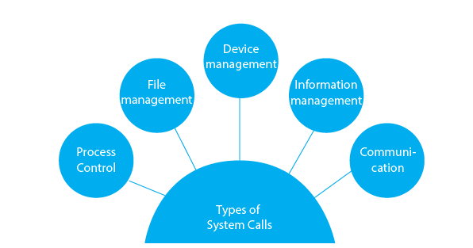
Types of system calls

Slide 17
✅ 1. Process Control
These system calls manage the execution of processes.
Examples:
fork() – create a new process
exec() – execute a new program
exit() – terminate the current process
wait() – wait for a process to finish
getpid() – get process ID
kill() – send a signal to a process

Slide 18
✅ 2. File Management
Used to create, read, write, and manage files.
Examples:
open() – open or create a file
read() – read from a file
write() – write to a file
close() – close a file
unlink() – delete a file
lseek() – move read/write file pointer (lseek(n,5,seek_cur))
chmod() – change file permissions

Slide 19
✅ 3. Device Management
For managing I/O devices.
Examples:
ioctl() – control device operations
read() / write() – also used for devices
open() / close() – same as file operations
mmap() – map device or file into memory

Slide 20
✅ 4. Information Maintenance
Provides information about the system and processes.
Examples:
gettimeofday() – get system time
settimeofday() – set system time
uname() – get system information
getuid() / getgid() – get user/group ID
alarm() – set a timer
sleep() – delay process execution

Slide 21
✅ 5. Communication (Inter-process Communication - IPC)
Used for communication between processes.
Examples:
pipe() – create a communication pipe(output of one p1 used as input to p2)
shmget() / shmat() – shared memory operations
msgget() / msgsnd() / msgrcv() – message queues
semget() / semop() – semaphores
socket() – create network socket
bind() / listen() / connect() – socket operations

Slide 22
System Call Implementation
HLL provide System Call Interface
Program makes API Call (application programming interface)
API trapped by RTL (run time library (glibc in linux))
RTL places system calls in register(write()=system call number 4 in linux)
Places parameters in specific locations and Completes System Call

Slide 23
Simple Analogy for Students 🎓
Think of it like ordering food at a restaurant:
HLL: You → want pizza 🍕 (write code).
API: You tell the waiter → “One pizza please” (API call).
RTL: Waiter understands menu & kitchen rules → translates your request.
System Call in Register: Waiter writes order on a slip (system call number).
Parameters: Size = Large, Toppings = Cheese (parameters).
OS Kernel (Kitchen): Prepares & serves the pizza 🍕 (executes request).
👉 So, students should remember:We call API → RTL converts → System call number goes to register → Parameters set → OS executes.

Slide 24

Time for Some MCQs
Notes:
C

Slide 25
When a user initiates to execute a C program, CPU runs in ____ mode.
a) user
b) kernel
c) supervisory
d) system
Notes:
User

Slide 26
a) user ✅

Slide 27
Which program signal for the occurrence of an event either from the hardware or the software?
a) Bootstrap program
b) Interrupt
c) Disk Controller
d) CPU

Slide 28
b) Interrupt ✅

Slide 29
Which type of interrupt is triggered when a program tries to access an invalid memory address?
a) Hardware interrupt b) Software interrupt c) Spurious interrupt d) Masked interrupt

Slide 30
b) Software interrupt ✅

Slide 31
The system call exec() is used for: a) Terminating a process b) Creating a new process c) Replacing the current process image with a new process image d) Reading a file

Slide 32
c) Replacing the current process image with a new process image ✅

Slide 33
File descriptor in a system call refers to: a) File type b) File location in secondary storage c) An integer representing an opened file d) File permissions

Slide 34
c) An integer representing an opened file

Slide 35
Process Management

Slide 36
Process Concept
A process is a program in execution.
Contains: program code, data, resources (files, memory, etc).
Differentiates from a program: active vs passive.

Slide 37
Process Life Cycle
The life cycle of a process includes several states:
New: Process is being created.
Ready: Waiting to be assigned to a CPU.
Running: Instructions are being executed.
Waiting (Blocked): Waiting for some event (like I/O).
Terminated: Finished execution.
Suspended: Process is temporarily moved out of main memory.

Slide 38
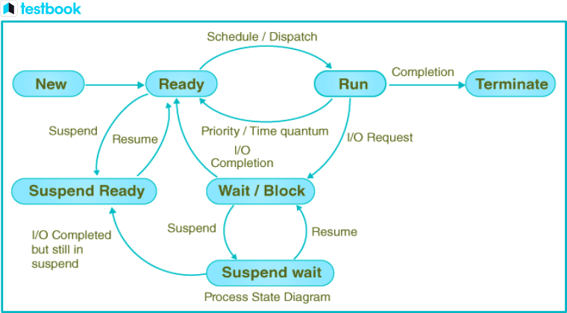

Slide 39
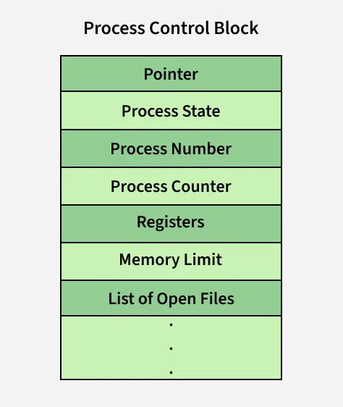
3. Process Control Block (PCB)
Each process is represented in the OS by a PCB, which contains:
Process ID (PID)
Process state
Program counter
CPU registers
Memory limits
Open files list
Accounting information
I/O status

Slide 40
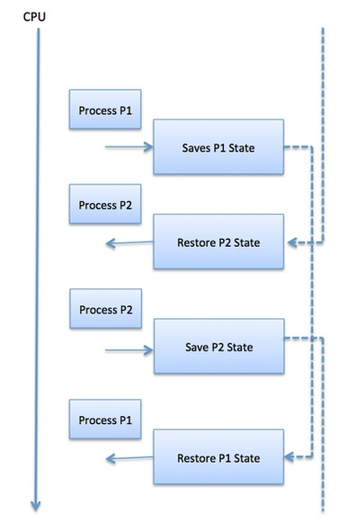
Context Switch
When CPU switches to another process, the system must save the state of the old process in the stack and load the saved state for the new process or reload the state of current process from stack.

Slide 41
Context Switch:
Save the current process's state (e.g., CPU registers, program counter, memory map).
Update process control blocks (PCBs).
Load the new process's saved state.
Transfer control to the new process.

Slide 42
Context Switching Process
The context switching process can be illustrated as follows:
Running Process A:
CPU is executing Process A.
Timer Interrupt/System Call:
A timer interrupt or system call occurs, indicating the need to switch processes.
Saving Context of Process A:
The OS saves the context of Process A into its Process Control Block (PCB). This includes saving registers, program counter (PC), stack pointer, etc.

Slide 43
Contd…
Scheduler Selects Process B:
The scheduler selects Process B for execution.
Loading Context of Process B:
The OS loads the context of Process B from its PCB, restoring registers, PC, stack pointer, etc.
Executing Process B:
The CPU now runs Process B.

Slide 44
Scheduling Queues
The OS maintains all PCBs in Process Scheduling Queues.
The OS maintains a separate queue for each of the process states and PCBs of all processes in the same execution state are placed in the same queue.
When the state of a process is changed, its PCB is unlinked from its current queue and moved to its new state queue.

Slide 45
Scheduling Queues
Schedulers fall into one of two general categories:
Non-Preemptive: In this case, a process's resource cannot be taken before the process has finished running. When a running process finishes and transitions to a waiting state, resources are switched.
Preemptive: In this case, the OS can switch a process from running state to ready state. This switching happens because the CPU may give other processes priority and substitute the currently active process for the higher priority process

Slide 46
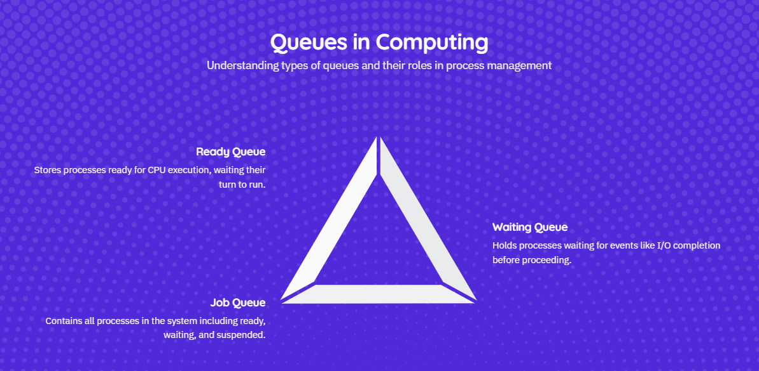

Slide 47
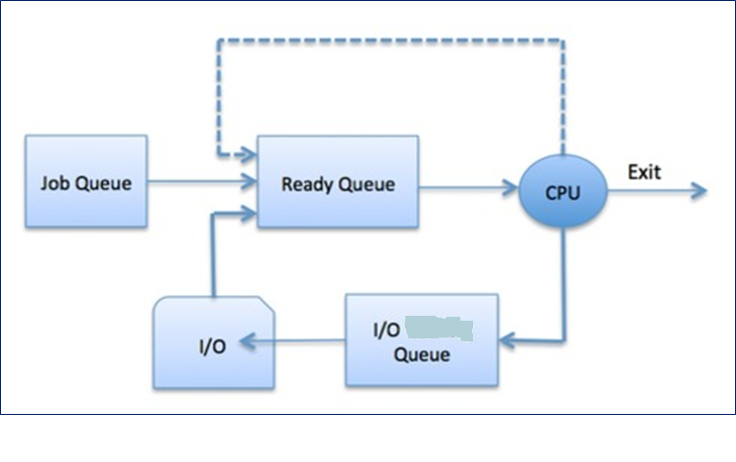
Process Scheduling Queues

Slide 48
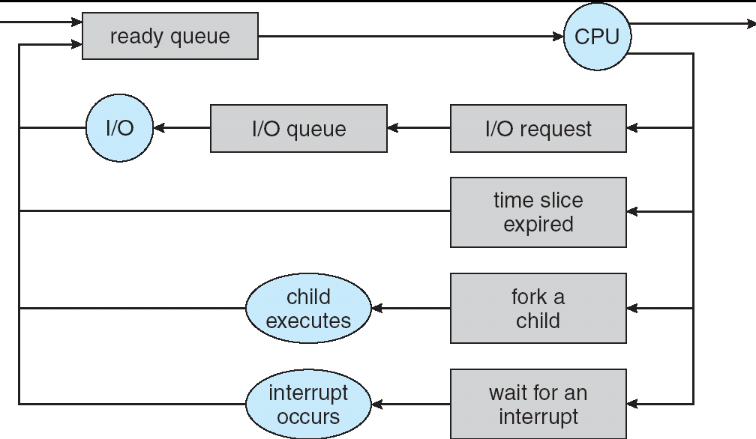
Representation of Process Scheduling
Queuing Diagram

Slide 49
4. Operations on Processes
Process Creation
Process Termination

Slide 50
Steps in Process Creation
Request for Process Creation A process is usually created by another process (called the parent process) via system calls. Example:
In Unix/Linux: fork()
In Windows: CreateProcess()
Assign a Unique Process ID (PID) The OS assigns a unique identifier to the new process.
Allocate Resources The OS allocates necessary resources like memory, I/O devices, and CPU time.

Slide 51
Copy Process Attributes The new process (child) may inherit attributes from the parent:
Open file descriptors
Working directory
Environment variables
Load Program into Memory The executable program is loaded into the memory space of the new process.
Add to Scheduler The process is put into the ready queue and is scheduled for execution.

Slide 52
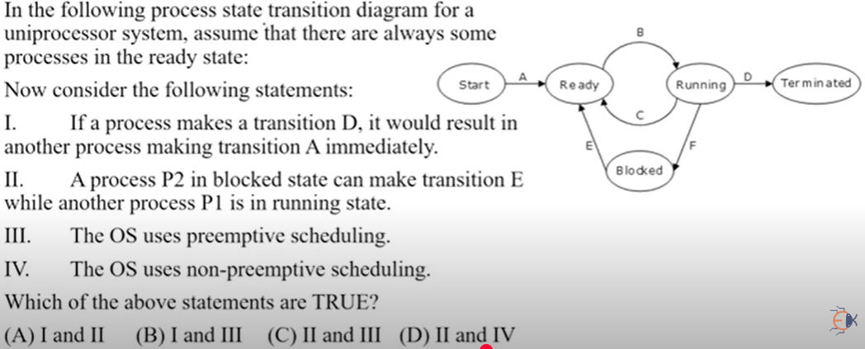

Slide 53
✅ Answer is option C

Slide 54
fork()
System call fork() is used to create processes.
It takes no arguments and returns a process ID.
The purpose of fork() is to create a new process, which becomes the child process of the caller.
After a new child process is created, both processes will execute the next instruction following the fork() system call.

Slide 55
What it Does:
fork() splits the current process into two.
After fork(), there are two processes:
Parent: continues from where fork() was called.
Child: is a copy of the parent.
Return Values:
Return Value | Meaning
0 | Returned in the child process
>0 | Returned in the parent, value is the PID of child
-1 | Fork failed (e.g., too many processes)

Slide 56
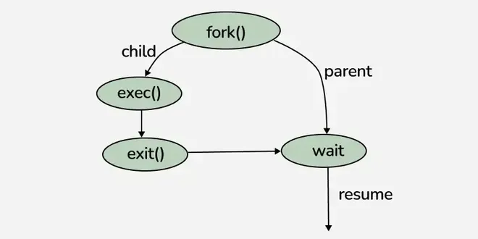

Slide 57
lseek()
Parameters
fd → File descriptor (returned by open()).
offset → Number of bytes to move the file pointer.
whence → Starting point for the offset. It can be:
SEEK_SET → Offset is set to offset bytes from the beginning of the file.
SEEK_CUR → Offset is set to current file position + offset.
SEEK_END → Offset is set to file size + offset.
Return Value:
On success: returns the resulting offset (new file position in bytes).
On Failure: returns -1 and sets errno.
The lseek() system call in Unix/Linux is used to reposition the file offset (read/write pointer) of an open file descriptor to a specific location within the file, without performing any actual read or write operation.
Syntax : lseek(fd, offset, whence)

Slide 58
int fd = open("file.txt", O_RDWR);
lseek(fd, 20, SEEK_CUR);
lseek(fd, 10, SEEK_CUR);
If initial offset = 0, what will be final offset?
a) 10
b) 20
c) 30
d) Undefined
Answer: c) 30 👉 First seek adds 20 → offset = 20, next adds 10 → offset = 30.

Slide 59
Time for Some MCQs
Notes:
C

Slide 60
What is the purpose of the Process Control Block (PCB)? a) To store user input b) To manage system memory c) To store process-specific information d) To compile the program

Slide 61
✅ Correct Answer: c) To store process-specific information

Slide 62
int fd = open("file.txt", O_RDWR);
lseek(fd, -10, SEEK_END);
If file size = 200 bytes, what will be the new offset? a) 190 b) 200 c) -10 (error) d) Undefined

Slide 63
Answer: a) 190👉 SEEK_END = size of file (200). 200 - 10 = 190.

Slide 64
Which of the following is shared between parent and child processes created using fork()? a) Stack b) Process ID c) Open file descriptors d) Execution time

Slide 65
✅ Correct Answer: c) Open file descriptors
As Both parent and child share the same entries in the system-wide Open File Table.

Slide 66
Which of the following is used to replace the memory space of a process after a fork()? a) wait() b) clone() c) exec() d) kill()

Slide 67
✅ Answer is exec(), because it loads a new program into the process memory after a fork()

Slide 68
What does the wait() system call do in process management? a) Forces the child process to run b) Suspends execution of parent until child terminates c) Terminates the current process d) Blocks all running processes

Slide 69
✅ Correct Answer: b) Suspends execution of parent until child terminates

Slide 70
What is returned by fork() in the child process? a) -1 b) 0 c) 1 d) PID of the parent

Slide 71
✅ Correct Answer: b) 0

Slide 72
References
1. Operating System Concepts :Authors: Abraham Silberschatz, Peter B. Galvin, Greg Gagne
2. Modern Operating Systems: Author: Andrew S. Tanenbaum
3. Operating Systems: Internals and Design Principles by William Stallings
4. GeeksforGeeks – CPU Scheduling 🔗 https://www.geeksforgeeks.org/cpu-scheduling-in-operating-systems/
5. TutorialsPoint – Operating System Scheduling
🔗 https://www.tutorialspoint.com/operating_system/os_process_scheduling_algorithms.htm

